Slide 1
Dental Clinic Database
Members:
Nathan Beimnet Gebrezghi Wendell Destang

Slide 2
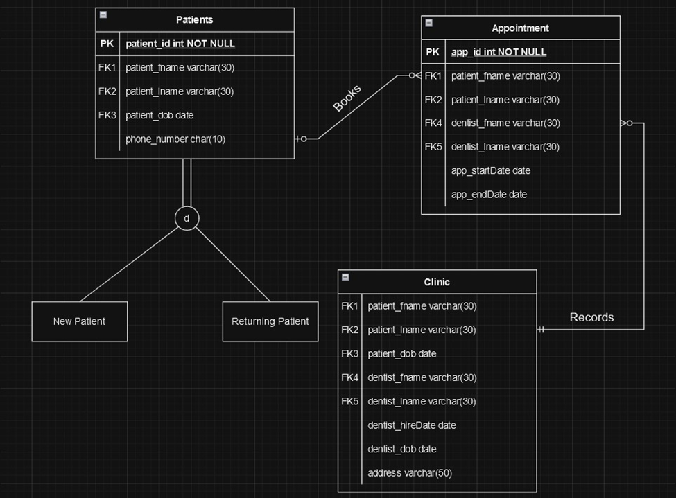
EER Diagram
Our project will be based on a dental clinic
This diagram helps to establish relationships between patients and appointments, with clinic

Slide 3
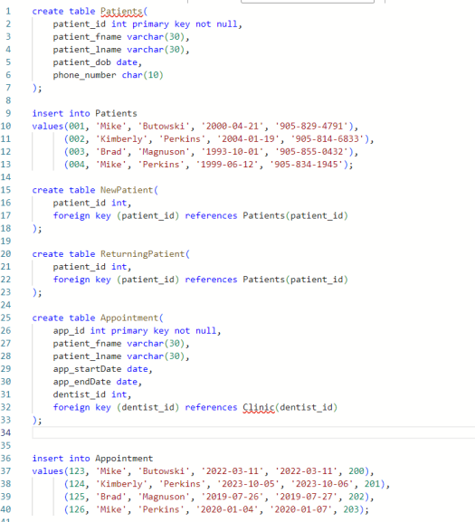
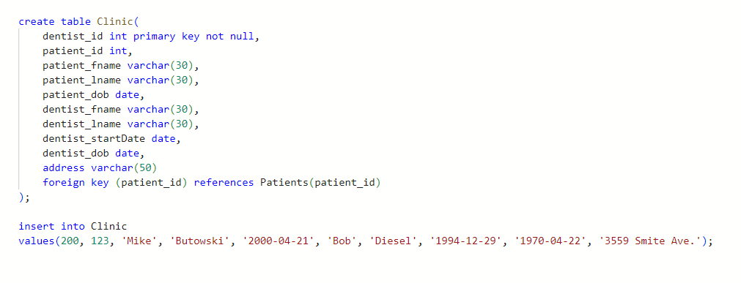
SQL Database Creation & Queries

Slide 4
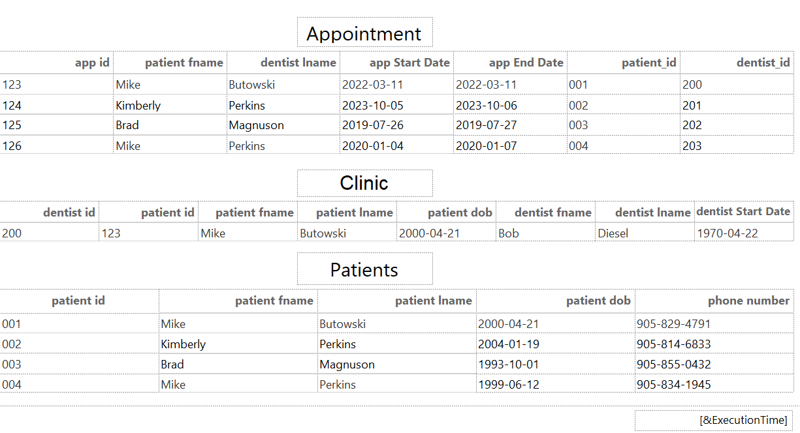
Reports created using Report Builder

Slide 5
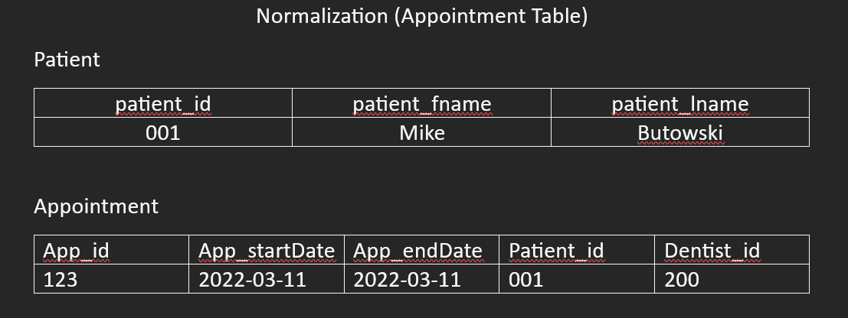
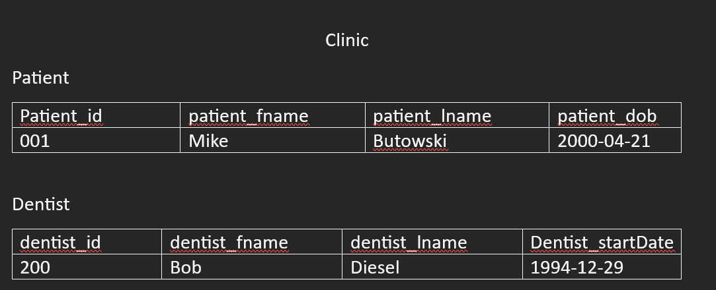
Normalized Database Schema

Slide 6
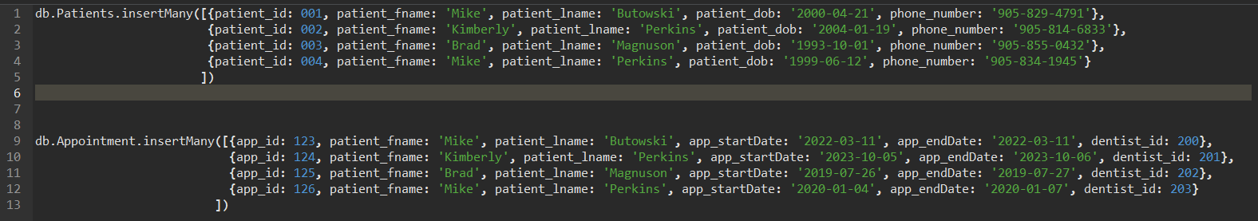
Mongo DB Collections

Slide 7
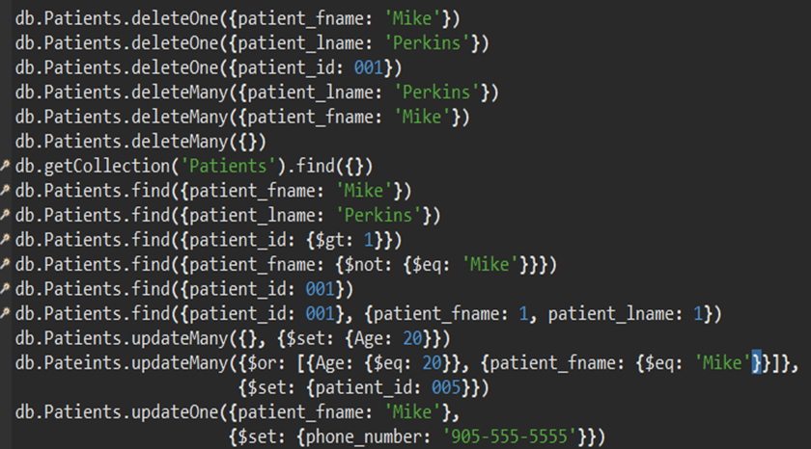
NoSQL Queries

Slide 8
Thanks for watching!

